Slide 1
Credit Card Fraud Detection using Machine Learning

Slide 2
Group Members
Names | Admission
Hasini Reddy Chilipireddy | 700734555
Vanitha Velagala | 700735152
Sagar Lanke | 700740230
Srikanth Majhi | 700729264

Slide 3
Member’s responsibilities
Name | responsibility
Hasini Reddy Chilipireddy | Motivation and objectives
Vanitha Velagala | Problem statement and implementation of solution
Srikanth Majhi | Proposed solution and related works
Sagar Lanke | Implementation and simulations

Slide 4
Motivation
The use of mobile and digital baking is growing. Many people all around the world now lead easier lives as a result of the employment of these techniques. Additionally, new emerging technologies like e-commerce, remote support, digital learning, and others have compelled numerous people, companies, and corporations to use digital payment methods.
The use of digital payment systems does, however, come with a number of difficulties for which many people and businesses yearn for answers. With credit card fraud cases rising everyday all over the world, it has become a major problem for digital banking and money transfers. This highlights the urgent need for a long-lasting digital solution that can stop this issue in real-time, eliminating financial loss, as well as saving people and organizations time spent identifying legitimate from phony transactions.

Slide 5
Objectives
To build an application that deploys supervised machine learning techniques and algorithms in the verification of transactions.
To build a machine learning pipeline that can score high accuracy even on new data.
To build a machine learning application that has a perfect tradeoff between training time, and performance.
To build a credit fraud detection machine learning that is not biased by imbalanced data.

Slide 6
Related Works
Sift - Sift provides global coverage and protection for leading payment methods. Watch the demo. Proactively stop digital fraud, chargebacks & easily detect fraud trends on your site. Prevent Content Spam. Detect Payment Fraud. Chargeback Prevention. Block Fake Accounts.
Seon - Built with advanced tools and real-time detection, SEON gives your online business the next wave of anti-fraud solutions.services offered are like Day one protection ,Real-time data enrichment ,Flexible integration, Boost revenue opportunities

Slide 7
Problem Statement
There is increased adoption of mobile and digital banking which makes it faster to process payments however, present multiple challenges, that many individuals and corporate entities face like Credit card fraud which is a key challenge to digital money transfer, and banking . With daily increasing cases of fraud across the globe we need to develop a safer way for authenticating transactions.

Slide 8
Proposed Solution
A credit card fraud machine learning application which solves the problem of credit card fraud, both in money transfer, and service acquisition.
A machine learning application that can verify the authenticity of transactions in real-time (at the point of sale or transaction), which will greatly help alleviate fraud by reducing the time needed to verify a single transaction in traditional systems.

Slide 9
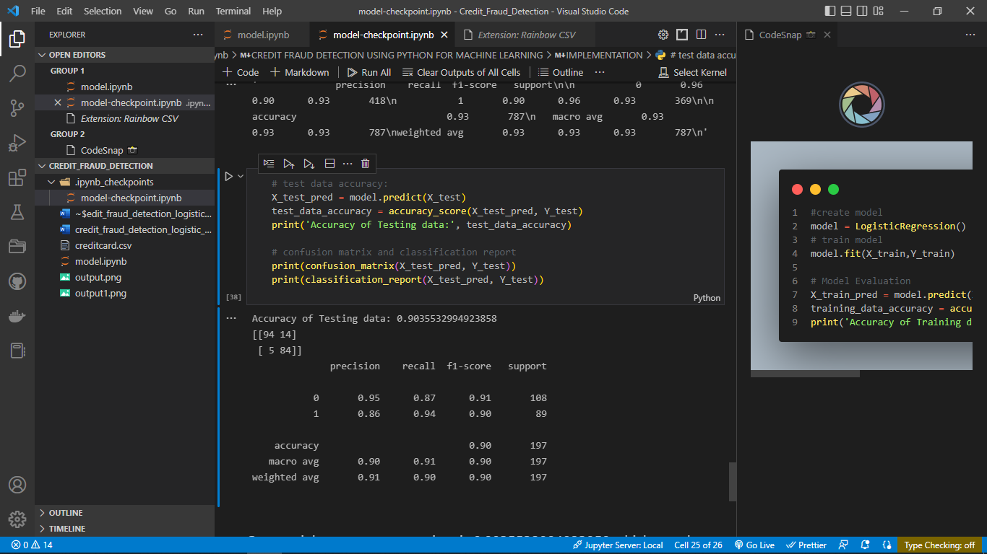
Results/Simulations
The model scores a general accuracy of 90.35%.
The confusion matrix score indicates 94% correctly classified True Positives (TP), and 84% correctly classified True Negatives (TN). There are 5% of values classified as fraud that is not fraud and 14% of cases classified as authentic despite them being a fraudulent transaction.
This misclassification penalty is evidenced by the 87% Recall score.

Slide 10
References
Linear Regression Model: Machine Learning Article - https://towardsdatascience.com/linear-regression-model-machine-learning-9853450c8bce
The research of regression model in machine learning field - https://www.matec-conferences.org/articles/matecconf/pdf/2018/35/matecconf_ifid2018_01033.pdf

